Slide 1
Chapter 2: Intro to Relational Model

Slide 2
Relational Model
Relational data structure(syntax)
Integrity constraints (semantic)
  constraints on attributes of schemas, e.g. value domain, type
  constraints on dependencies among attributes of a schema
  constraints on dependencies among attributes of different schemas
    relational normal forms (范式)
Operations on the model

Slide 3
Review Data Model
Data Model
  a collection of conceptual tools for describing
    data
    data relationships (数据联系)
    data semantics (数据语义)
    consistency constraints (一致性约束)
A data model provides a way to describe the design of a database at the physical, logical, and view levels.

Slide 4

Example of a Relation
attributes
(or columns)
tuples
(or rows)

Slide 5
§2.1 Structure of Relational Databases
A relational database consists of a collection of relational tables
  a row in a table represents a relationship among a set of values
  a table is such a collection of relationships.
2.1.1 Basic structure
Given sets D₁, D₂, …. D_{n} , a relation r is a subset of
D₁ ╳ D₂ ╳ … ╳ D_{n}
  r = {(a₁, a₂, …, a_{n} )} ⊆ D₁ ╳ D₂ …..╳ D_{n}
  relation r = { tuple } /*元组

Slide 6
2.1.1 Basic Structure (cont.)
Attributes of relation r
  A₁, A₂, …, A_{n}
  domain of the relation’s attributes D₁, D₂, …. D_{n}
    the set of allowed values for each attribute
Notes
  relation r in DBS is the limited set (有限集合)
  attributes in tuples are non-oredered (无序性)
    e.g. (d₁, d₂, …, d_{n}) = (d₂, d₁, …, d_{n})
  the order in which the tuples appear in a relations is irrelevant
  several attributes may have the same domain

Slide 7
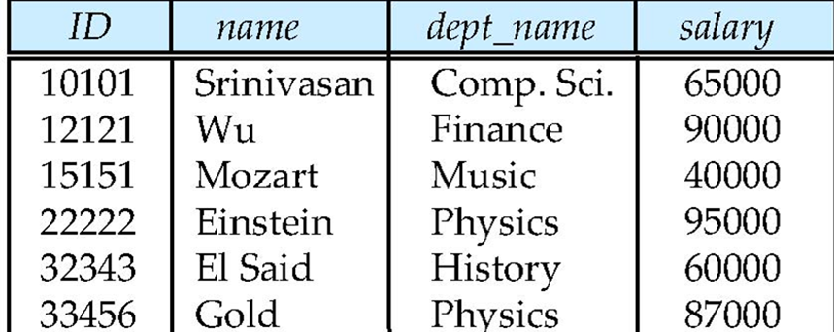
§2.1 Structure of Relational Databases
A relational database consists of a collection of relational tables
  a row in a table represents a relationship among a set of values
  a table is such a collection of relationships.
As an example, we consider the table instructor, a row in the table can be thought of as representing the relationship between a speciﬁed ID and the corresponding values for name, dept_name, and salary values.

Slide 8
§2.1 Structure of Relational Databases
Relation 关系
  A relation is a table with columns and rows. 二维表
Attribute (columns, field) 属性（列，字段）
  An attribute is a named column of a relation.
Domain 域
  A domain is the set of allowable values for one or more attributes.
Tuple (row, record) 元组（行，记录）
  A tuple is a row of relation.

Slide 9
2.1.1 Basic Structure (cont.)
Intension 内涵 关系的结构以及域、取值限制
  The structure of a relation, together with a specification of the domains and any other restrictions on possible values
Extension 外延 元组
  The tuples are called extension (or state)
Degree (arity) 目，度，维
  The degree of a relation is the number of attributes it contains（属性的个数）
Cardinality 基数
  The cardinality of a relation is the number of tuples it contains（元组的数量）

Slide 10
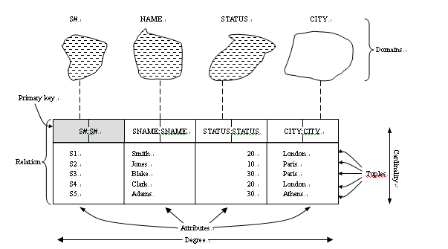
2.1.1 Structure of Relational Model
  Main concept of Table

Slide 11
2.1.1 Basic Structure (cont.)
Not all tables qualify as a relation.
Requirements:
  Every relation must have a unique name.
  Attributes (columns) in tables must have unique names.
  All tuples in a relation have the same structure;
  Every attribute value is atomic (not multivalued, not composite).
  Every row is unique

Slide 12
2.1.1 Basic Structure (cont.)
Why Relations?
  Provides a simple, limited approach to structuring data.
  Provides a limited, yet useful, collection of operations on data.
  They allow us to implement languages, such as SQL, that enable the programmer to express their wishes at a very high level.

Slide 13
Relation Schema 关系模式
Relation schema = relation name and the set of attributes.
  关系模式是对关系表中每个列的描述。关系模式需要给出关系名、每个属性的名称、属性的域及属性和域之间的映射关系。
  Example:
  Movies (title, year, length, genre) or
  Movies (title: string, year: integer, length: integer, genre: string)
We can reorder the attributes of a relation, without changing the relation.
  Example:
  Movies (year, title, length, genre)
<number>/100

Slide 14
2.1.1 Basic Structure (cont.)
Attribute Types
The set of allowed values for each attribute is called the domain of the attribute
Attribute values are (normally) required to be atomic; that is, indivisible
A domain must be an elementary type, such as integer, char(n), date, time.
all domains of R should be atomic, first formal norm
e.g. multivalued attribute values are not atomic, { {1,2}, {4}, {4,6,7} }
e.g. composite attribute address={city, street, zipcode} is not atomic( or atomic?)

Slide 15
2.1.1 Basic Structure (cont.)
Null
  the special value null is a member of every domain.
  Null is useful because using an ordinary value with special meanings does not always work;
  E.g if salary=-1 is used for “unknown”, then averages won’t be sensible;
  the null value causes complications in the definition of many operations
  Null value is NOT 0 of integer, NOT empty string , it is JUST NULL.

Slide 16
§2.2 Database Schema
The concept of a relation schema corresponds to the programming-language notion of type deﬁnition
For attributes A₁, A₂, …, A_{n} , R = (A₁, A₂, …, A_{n} ) is a relation schema
R = (A₁, A₂, …, A_{n} ) is a relation schema
Example: instructor _schema = (ID, name, dept_name, salary)
orders of attributes is irrelevant
Formally, given sets D₁, D₂, …. D_{n} a relation r is a subset of
D₁ x D₂ x … x D_{n}
Thus, a relation is a set of n-tuples (a₁, a₂, …, a_{n}) where each a_{i} ∈ D

Slide 17
Relation Schema 关系模式
Relation schema = relation name and the set of attributes.
  关系模式是对关系表中每个列的描述。关系模式需要给出关系名、每个属性的名称、属性的域及属性和域之间的映射关系。
  Example:
  Movies (title, year, length, genre) or
  Movies (title: string, year: integer, length: integer, genre: string)
We can reorder the attributes of a relation, without changing the relation.
  Example:
  Movies (year, title, length, genre)
<number>/100

Slide 18

Relations are Unordered
Order of tuples is irrelevant (tuples may be stored in an arbitrary order)
Example: instructor relation with unordered tuples
属性attributes
schema
Tuples元组

Slide 19
Relation Instance
The concept of a relation instance corresponds to the programming-language notion of a value of a variable.
Relation instance: the current values of a relation r at a particular time, where r=r(R) is a relation on the relation schema R.
the contents of a relation instance (value of variable) may change with time, but the schema of a relation (data type of variable) does not generally change
Database schema
  A set of relation schemas, each with a distinct names. logical design of the database （ set of all relation schemas in the database.）
Database instance
  a snapshot of the data in the database at a given instant in time.

Slide 20
Database
A database consists of multiple relations
Information about an enterprise is broken up into parts
instructor
student
advisor
Bad design:
univ (instructor -ID, name, dept_name, salary, student_Id, ..)
results in
  repetition of information (e.g., two students have the same instructor)
  the need for null values (e.g., represent an student with no advisor)
Normalization theory (Chapter 7) deals with how to design “good” relational schemas

Slide 21
Relational Database
Tables are the logical structure , not a physical structure
The Information Principle
    The entire information content of the database is represented in one and only one way, namely as explicit values in column positions in rows in tables
    There are no pointers connecting one table to another.
Catalog / Dictionary(数据字典)
  The place where all of various schemas and all of the corresponding mappings are kept.
  Is called descriptor information or metadata(元数据)
  Relation is its structure

Slide 22
Preliminary Definitions
§2.3 Keys
Tabular representation of r(R):
  the current values of a relation r(R) (i.e. relation instance of the relation r ) are specified by a table
  an element t in set r is a tuple, represented by a row in a table
  tuple variable t, t[A_{i}] = the value of t on the attribute A_{i} , or t[{ A_{i} }] = the value set of t on the attribute set { A_{i} }
    e.g. t₂[name]= ‘Wu’

Slide 23

Preliminary Definitions
Exercise: what is t, t[A_{i}], and t[{A_{i}}] respectively?

Slide 24
§2.3 Keys（superkey)
A superkey (超码) is a set of one or more attributes that, taken collectively, can be used to identify uniquely a tuple in the relation
  One or more columns whose values are sufficient to identify a row.
  Key is a property of a table schema.

Slide 25
2.3 Keys (Candidate Key)
A superkey may contain extraneous attributes. If K is a superkey, then so is any superset of K
We are often interested in superkeys for which no proper subset is a superkey.
Such minimal superkeys are called candidate keys(CK 候选码)（ K的任意子集不再是超码)
A relation may has one or more CKs
  e.g.{id} is a candidate key for instructor, assuming no two instructors can possibly have the same id

Slide 26
2.3 Keys ( Primary Key)
Primary key (主码) denotes a candidate key that is chosen by the database designer as the principal means of identifying tuples within a relation.
  Select one of the candidate keys to use primarily as primary key. The remaining candidate keys are called alternate keys(备选码）.
  Primary keys are unique, minimal identifiers in a relation
  A relation can has only one PK.
Primary keys must be chosen with care. The primary key should be chosen such that its attribute values are never, or very rarely, changed

Slide 27
2.3 Keys (cont.)
A key (whether primary, candidate, or super) is a property of the entire relation, rather than of the individual tuples.
Any two individual tuples in the relation are prohibited from having the same value on the key attributes at the same time.
The designation of a key represents a constraint in the real-world enterprise being modeled. (entity integrity constraint)

Slide 28
2.3 Keys (cont.)
The relation between Superkey and Key(候选码)
  Thus a key is always a superkey, but a key has the additional property that no proper subset is a superkey.
  Once such keys are defined, it becomes impossible for normal updates of table (inserting new rows or updates of column values of existing rows) to cause the uniqueness condition for such keys to fail.
  Theoretically, A table can have more than one key, but at least one key must exist for any relation.

Slide 29
§2.3 Keys(Foreign Key )
A relation, say r₁, may include among its attributes the primary key of another relation, say r₂. This attribute is called a foreign key (外码) from r₁, referencing r₂.
The relation r₁ is also called the referencing relation of the foreign key dependency, and r₂ is called the referenced relation of the foreign key.

Slide 30
2.3 Referential Integrity Constraint
a referential integrity constraint (参照完整性) requires that
the values appearing in speciﬁed attributes of any tuple in the referencing relation
also
appear in speciﬁed attributes of at least one tuple in the referenced relation.
Actually, referential integrity constraint is often used to restrict the value of foreign key: Value of the foreign key in referencing relation must appear in primary key of the referenced relation, null otherwise.
SSDUT-Software School of DUT

Slide 31
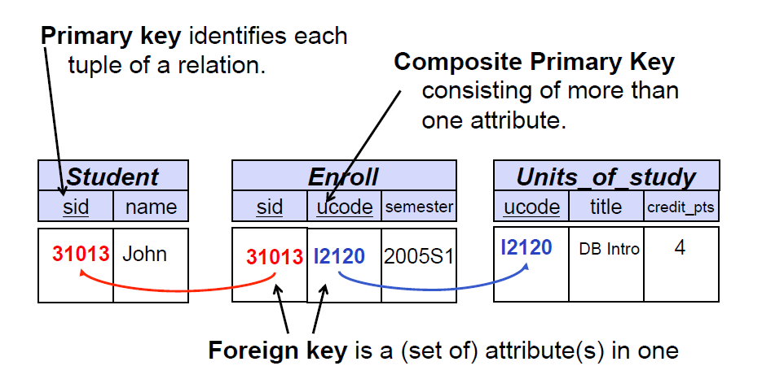
2.3 Referential Integrity Constraint
  Example:
    student(id, name, dept_name,tot_cred)
    Department( dept_name, building, budget )
  Attribute dept_name in student is a Foreign Key of table student.

Slide 32
§2.3 Keys(cont.)
The choice of keys
  First, the semantics of the application 应用语义
  Secondly, pragmatic considerations such as the storage requirements of the values and the cost of comparisons 存储、代价
    A value of type integer requires less space than any character string of length greater than 4, and comparing numbers is much cheaper than comparing character strings. 整数常常比长字符串好
    A composite key, which consists of more than one column, is more expensive than a simple, single-attribute key.单属性主码比复合主码好

Slide 33
§2.3 Keys(cont.) Keys and NULL
PRIMARY KEY
  Must be unique and do not allow NULL values
UNIQUE (candidate key)
  Possibly many candidate keys (specified using UNIQUE)
  According to the ANSI standards SQL:92, SQL:1999, and SQL:2003,a UNIQUE constraint should disallow duplicate non-NULL values,but allow multiple NULL values.
  Many DBMS (e.g. Oracle or SQL Server) implement only a crippled version of this, allowing a single NULL but disallowing multiple NULL values….
FOREIGN KEY
  By default allows nulls
  If there must be a parent tuple, then must combine with NOT NULL
  constraint

Slide 34

§2.4 Schema Diagram for University Database
箭头表外关键字，被指—被参照，

Slide 35
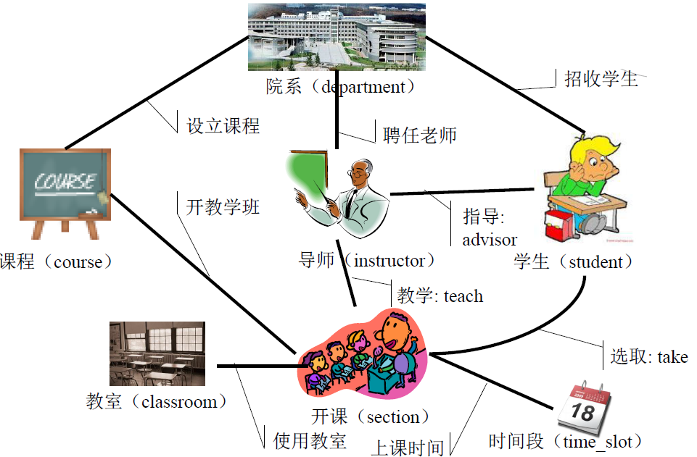
§2.4 Schema Diagram for University Database

Slide 36
Relational Summary
Properties of Relations 关系的特点：
  A distinct relation name 关系不重名：每张表不同名
  Every cell is an atomic (single) value 单元格不可再分：表里每格的值不可再分割
  A distinct attribute name 属性不重名：每列不同名
  An attribute values are from the same domain 一个属性来自同一个域：同一取值范围
  no duplicate tuples 元组不重复：每行值不同,可通过一个标志来唯一找出某一行关键字
  the order of attributes has no significance 列的顺序无所谓
  the order of tuples has no significance （理论上）行的顺序无所谓（实际会影响元组访问效率）

Slide 37
§2.5 Relational Query Languages
Query Language
  the language in which user requests information from the database
Procedural vs.non-procedural, or declarative
“Pure” languages:
  Relational algebra
  Tuple relational calculus
  Domain relational calculus
Relational operators

Slide 38
§2.5 Relational Query Languages
classroom(building, room_number, capacity)
department(dept_name, building, budget)
course(course_id, title, dept name, credits)
instructor(ID, name, dept name, salary)
section(course_id, sec_id, semester, year, building, room number, time_slot_id)
teaches(ID, course_id, sec_id, semester, year)
student(ID, name, dept_name, tot_cred)
takes(ID, course_id, sec_id, semester, year, grade)
advisor(s_ID, i_ID)
time slot(time_slot_id, day, start_time, end_time)
prereq(course_id, prereq_id)

Slide 39
Relational Algebra
Basic operations:
  Selection (σ ) Selects a subset of rows from relation.
  Projection (∏) Deletes unwanted columns from relation
  Cross-product ( X ) Allows us to combine two relations
  Set-difference ( - ) Tuples in reln. 1, but not in reln. 2.
  Union ( ∪ ) Tuples in reln. 1 and in reln. 2.
{σ , ∏ , X , -, ∪ } is a complete operation set. Any other
  relational algebra operations can be derived from them.

Slide 40

Selection of tuples
The select operation σ on r (R) selects tuples that satisfy a given predicate, resulting in a subset of r
SQL statement
Select * From r Where P
Relation r
Select tuples with A=B and D > 5
σ _{A=B and D > 5} (r)

Slide 41
Select Operation
Notation: σ _{p}(r)
p is called the selection predicate
Defined as:
σ_{p}(r) = {t | t ∈ r and p(t)}
Where p is a formula in propositional calculus consisting of terms connected by : ∧ (and), ∨ (or), ¬ (not)
Each term is one of:
<attribute> op <attribute> or <constant>
where op is one of: =, ≠, >, ≥. <. ≤
Example of selection:
σ _{branch-name=“Perryridge”}(account)
谓词
<number>/100

Slide 42

Selection of Columns (Projection)
Relation r:
Select A and C
  Projection
  Π _{A, C} (r)

Slide 43
Project Operation 投影
Notation:
∏_{A1, A2, …, Ak} (r)
where A₁, A₂ are attribute names and r is a relation name.
The result is defined as the relation of k columns obtained by erasing the columns that are not listed
Duplicate rows removed from result, since relations are sets
E.g. To eliminate the branch-name attribute of account
∏_{account-number, balance} (account)
保留的字段
被投影的关系
<number>/100

Slide 44
Cartesian-Product Operation
SQL Statement:
Select *
From r, s
Cartesian-product operation on relation r and s
r ╳ s = {t | t = t₁ t₂ and t₁∈ r and t₂ ∈ s }
A
B
C
D
E
A
B
C
D
E
t₁
α
β
1
2
α
β
β
γ
10
10
20
10
a
a
b
b
α
α
α
α
β
β
β
β
1
1
1
1
2
2
2
2
α
β
β
γ
α
β
β
γ
10
10
20
10
10
10
20
10
a
a
b
b
a
a
b
b
t₂
t
r
s
r ╳ s

Slide 45
Cartesian-Product Operation
完全搭配：
比喻，架次， 吨公里，学生-课程
Notation r x s
Defined as:
r x s = {t q | t ∈ r and q ∈ s}
Assume that attributes of r(R) and s(S) are disjoint. (That is, R ∩ S = ∅).
If attributes of r(R) and s(S) are not disjoint, then renaming must be used.
如属性相交，要更名
<number>/100

Slide 46
Cartesian-Product Operation
Cartesian-Product Operation(笛卡尔积操作)
Relations r, s:
A
B
C
D
E
α
β
1
2
α
β
β
γ
10
10
20
10
a
a
b
b
r
s
r × s:
A
B
C
D
E
α
α
α
α
β
β
β
β
1
1
1
1
2
2
2
2
α
β
β
γ
α
β
β
γ
10
19
20
10
10
10
20
10
a
a
b
b
a
a
b
b

Slide 47

Union of two relations
Relations r, s:
The 1st column of r deals with the same type of values(domain) as does the 1st column of s ,and 2nd column also, and also for all attributes.
r ∪ s:

Slide 48
Union Operation
属性集合相同
才能合并
Notation: r ∪ s = {t | t ∈ r or t ∈ s}
For r ∪ s to be valid.
1. r, s must have the same arity (same number of attributes)
2. The attribute domains must be compatible (e.g., 2nd column
of r deals with the same type of values as does the 2nd
column of s)
E.g. to find all customers with either an account or a loan
∏_{customer-name} (depositor) ∪ ∏_{customer-name} (borrower)
属性集合相同
才能合并
<number>/100

Slide 49

Set difference of two relations
Relations r, s:
r – s:

Slide 50
Set Difference Operation
属性集合相同
才能相减
Notation r – s
Defined as:
r – s = {t | t ∈ r and t ∉ s}
Set differences must be taken between compatible relations.
  r and s must have the same arity(drgee)
  attribute domains of r and s must be compatible
<number>/100

Slide 51

Set Intersection of two relations
Relation r, s:
r ∩ s

Slide 52
Set-Intersection Operation 交集
Notation: r ∩ s
Defined as:
r ∩ s ={ t | t ∈ r and t ∈ s }
Assume:
  r, s have the same arity
  attributes of r and s are compatible
Note: r ∩ s = r - (r - s)
r
s
<number>/100

Slide 53
Joining two relations – Natural Join
Let r and s be relations on schemas R and S respectively.
Then, the “natural join” of relations R and S is a relation on schema R ∪ S obtained as follows:
  Consider each pair of tuples t_{r} from r and t_{s} from s.
  If t_{r} and t_{s} have the same value on each of the attributes in R ∩ S, add a tuple t to the result, where
    t has the same value as t_{r} on r
    t has the same value as t_{s} on s

Slide 54
Natural join Example
Relations r, s:
A
B
C
D
B
D
E
α
β
γ
α
δ
1
2
4
1
2
α
γ
β
γ
β
a
a
b
a
b
1
3
1
2
3
a
a
a
b
b
α
β
γ
δ
∈
r
s
r s
A
B
C
D
E
α | 1 | α | a | α
α | 1 | α | a | γ
α | 1 | γ | a | α
α | 1 | γ | a | γ
δ | 2 | β | b | δ

Slide 55
Natural-Join Operation 自然连接
Notation: r s
Let r and s be relations on schemas R and S respectively.The result is a relation on schema R ∪ S which is obtained by considering each pair of tuples t_{r} from r and t_{s} from s.
If t_{r} and t_{s} have the same value on each of the attributes in R ∩ S, a tuple t is added to the result, where
  t has the same value as t_{r} on r
  t has the same value as t_{s} on s
Example:
R = (A, B, C, D)
S = (E, B, D)
Result schema = (A, B, C, D, E)
r s is defined as:
∏_{r.A, r.B, r.C, r.D, s.E} (σ_{r.B = s.B ∧ r.D = s.D} (r x s))
defined on the schema (A, B, C, D, E)
先叉后选最后投影
<number>/100

Slide 56
Natural-Join Operation 自然连接
Notation: r s
Let r and s be relations on schemas R and S respectively.The result is a relation on schema R ∪ S which is obtained by considering each pair of tuples t_{r} from r and t_{s} from s.
If t_{r} and t_{s} have the same value on each of the attributes in R ∩ S, a tuple t is added to the result, where
  t has the same value as t_{r} on r
  t has the same value as t_{s} on s
Example:
R = (A, B, C, D)
S = (E, B, D)
Result schema = (A, B, C, D, E)
r s is defined as:
∏_{r.A, r.B, r.C, r.D, s.E} (σ_{r.B = s.B r.D = s.D} (r x s))
先叉后选最后投影
<number>/100

Slide 57
Natural join Operation(自然连接)
Relations r, s:
A
B
C
D
B
D
E
α
β
γ
α
δ
1
2
4
1
2
α
γ
β
γ
β
a
a
b
a
b
1
3
1
2
3
a
a
a
b
b
α
β
γ
δ
∈
r
s
r s
A
B
C
D
E
α | 1 | α | a | α
α | 1 | α | a | γ
α | 1 | γ | a | α
α | 1 | γ | a | γ
δ | 2 | β | b | δ

Slide 58

Figure in-2.1

Slide 59
End of Chapter 2

Slide 60
Figure 2.01

Slide 61

Figure 2.02

Slide 62

Figure 2.03

Slide 63
Figure 2.04

Slide 64

Figure 2.05

Slide 65

Figure 2.06

Slide 66

Figure 2.07

Slide 67

Figure 2.10

Slide 68

Figure 2.11

Slide 69

Figure 2.12

Slide 70

Figure 2.13

